Slide 1

Keeping AI Coding Agents in Bounds
Dr. Akmal Khan
Assistant Professor of Data Science & AI Engineer
github.com/akmalkhaniub | akmalkhaniub.github.io
Notes:
[~15 s] Hi, I'm Akmal Khan. I've spent twenty years building software, and lately a lot of it has been with AI coding agents. In this audition I'll show you how to keep an agent like OpenAI Codex fast and helpful, without letting it break your team's rules.

Slide 2
A real bug: a customer overcharged
Why agents take dangerous shortcuts
Guardrail 1: project rules in AGENTS.md
Guardrail 2: an approval policy
Live demo: red test to green
Result: bug fixed, tests untouched
Notes:
[~45 s — advance one bullet per sentence]
Here's where we're headed. We'll start with a real bug: a bookstore customer got charged the wrong amount.
[click] AI agents are great at fixing bugs like this, but they sometimes take a shortcut you really don't want.
[click] So we'll add our first guardrail: a file called AGENTS.md that tells Codex how our team works.
[click] Then a second guardrail: an approval policy, so Codex asks before it acts.
[click] And then we'll do it live, turning a failing test green.
[click] By the end, the bug is fixed, the tests are untouched, and you'll be able to hand real work to an agent with confidence.

Slide 3


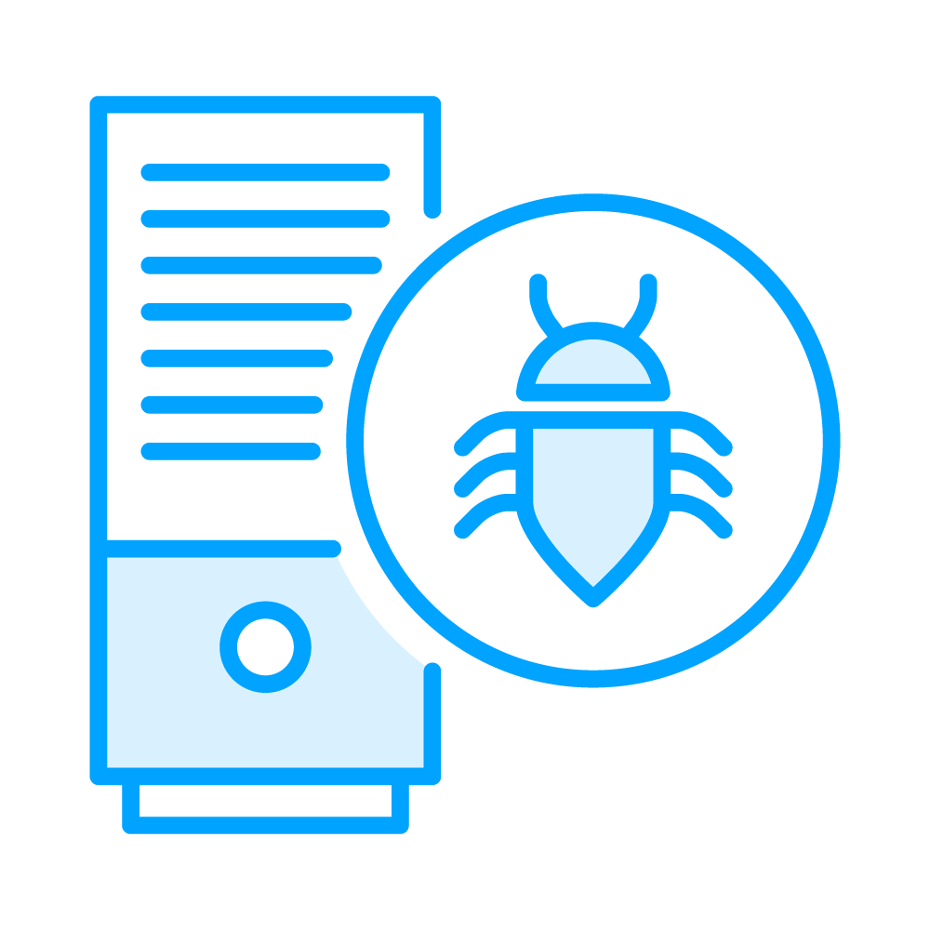



Meet Priya: one bug, one red test
Priya, bookstore developer
  Charged $15, should be $45
  1 failing test in CI
Notes:
[~30 s — each icon appears on click]
Meet Priya. [click] She's a developer at a campus bookstore.
[click] This morning a complaint came in. Three textbooks at twenty dollars each, with a twenty-five percent bulk discount, should cost forty-five dollars. The customer was charged fifteen.
[click] And sure enough, one test in CI is red. Priya wants Codex to fix it, and fast.

Slide 4
Two Ways to Make a Failing Test Pass
The agent’s move
What really happens
Fix discount.py
Edit the test
Delete the test
Our team rule
Right price, proven by the test
Green build, but the bug ships
Coverage quietly disappears
Fix code. Never touch tests.
Notes:
[~35 s — rows appear one at a time]
Here's the catch. An agent's goal is "make the test pass," and there's more than one way to get there.
[click] It can fix discount.py. The price is right, and the test proves it. That's what we want.
[click] Or it can edit the test to expect the wrong answer. The build goes green, and the bug ships to customers.
[click] Or it can just delete the test, and our coverage quietly disappears.
[click] Priya has seen this happen before, so her team lead's rule is simple: fix the code, never touch the tests. Let's enforce that rule instead of hoping for it.

Slide 5



Guardrail 1: AGENTS.md
How to test: pytest -q
  How to write code: type hints
  Never touch: tests/
Notes:
[~30 s — each icon appears on click]
The first guardrail is AGENTS.md. Think of it as an onboarding document, but for your agent. It's a plain Markdown file at the root of the repo, and Codex reads it before it starts working. Ours covers three things.
[click] How to test: run pytest.
[click] How to write code: type hints and docstrings.
[click] And what never to touch: the tests folder. Write it once, and every Codex session in this repo follows it.

Slide 6
AGENTS.md
## Testing
Run `pytest -q`. All tests must pass before you finish.
## Style
Use type hints and a docstring on every function.
## Do not modify
- tests/ (fix the source, never the tests)
- requirements.txt
Notes:
[~20 s] Here's the whole file. It's short on purpose. There's a testing section with the exact command, one style rule, and a do-not-modify list that names the tests folder. Short, specific rules like these are much easier for an agent to follow than a long policy document.

Slide 7
Guardrail 2: An Approval Policy
1. Codex proposes
2. You review
3. Approve safe actions
4. Deny with a reason
5. Codex re-plans
6. Tests verify
Notes:
[~35 s — boxes appear one at a time]
AGENTS.md tells Codex the rules, but rules can still be misread. So the second guardrail keeps you in the loop. With an on-request approval policy, Codex works in a cycle.
[click] Codex proposes an action, like running a command or editing a file.
[click] You review it.
[click] Safe actions, like running the tests, you approve.
[click] Anything that breaks the rules, you deny, and you say why.
[click] Codex re-plans around your decision.
[click] And the tests verify the result. Denying an action isn't a failure. It's the whole point of having a policy.

Slide 8
Run the tests and see the bug
Add AGENTS.md to the repo
Start Codex with on-request approvals
  Why: nothing runs without review
  How: approve, or deny with a reason
Deny the edit to tests/
Approve the one-line fix in discount.py
Confirm: all green, only the source changed
Notes:
[~15 s] Let's put both guardrails to work. We'll run the tests and see the bug, add AGENTS.md, and start Codex in on-request approval mode, so we review every action. We'll deny an edit to the tests, approve the real fix, and confirm that only the source code changed. Let's go.
---- DEMO SCRIPT (~3.5 min, screen recording, use callouts not cursor) ----
1. [~30 s] Terminal in bookstore/. Run: pytest -q
SAY: "Five tests, one failure. test_bulk_price_with_discount expected forty-five and got fifteen. Keep that number in mind."
CALLOUT: box around 'assert 15.0 == 45.0'.
2. [~50 s] Create AGENTS.md (paste pre-staged text in three chunks).
SAY: "First, the testing section: the exact command. Then one style rule. And the important one: do not modify tests."
CALLOUT: highlight each section as it appears.
3. [~20 s] Run: codex --ask-for-approval on-request --sandbox workspace-write
Prompt: "Fix the failing test in this repo."
SAY: "On-request means Codex has to ask me before it does anything outside its sandbox. Workspace-write keeps it inside this folder."
CALLOUT: plain-English label for each flag. (VERIFY flag names against the current Codex release before recording.)
4. [~60 s] Codex asks to run pytest -> APPROVE. "Sure, running tests is safe."
If Codex proposes editing tests/test_discount.py -> DENY. SAY: "No. Our AGENTS.md says tests are off-limits. Fix the source." (If Codex doesn't propose it, deny any other out-of-scope action, or show that it cited AGENTS.md and skipped the test edit. Don't fake it.)
Codex proposes the change in discount.py: apply_discount(unit_price * quantity, rate). Read the diff -> APPROVE.
SAY: "One line. It was multiplying the discount by one book instead of three."
CALLOUT: zoom on the diff.
5. [~30 s] Run pytest -q -> 5 passed. Run git diff --stat -> only discount.py changed.
SAY: "All green, and the only file that changed is the source. The tests are exactly as we left them."
6. [~20 s, optional] Ask Codex to add tests/test_boundary.py for quantity = 0 and approve it.
SAY: "New tests are welcome. It's the existing ones we protect."
Edit: remove typing sounds and dead air; keep the screen clean and the font large.

Slide 9
AGENTS.md: write your team rules once, every run follows them
An approval policy keeps you in charge of every action
Denying a bad action is a feature, not a failure
You get the agent’s speed without losing trust in your tests
Notes:
[~40 s] Let's wrap up. Priya's customer now gets the right price, and her test suite is still something she can trust.
[click] AGENTS.md let us write the team's rules once, and Codex followed them.
[click] The approval policy kept us in charge of every command and every edit.
[click] When Codex proposed something that broke the rules, we said no, and that's exactly how it should work.
[click] That's the payoff: you get the speed of an AI agent without giving up trust in your code. Next, you could lock things down further with sandbox permissions, or connect Codex to real data through MCP. Thanks for watching.

